Slide 1
Anomaly detection

Slide 2
Proximity-Based Approaches: Distance-Based vs. Density-Based Outlier Detection
Intuition: Objects that are far away from the others are outliers
Assumption of proximity-based approach: The proximity of an outlier deviates significantly from that of most of the others in the data set
Two types of proximity-based outlier detection methods
Distance-based outlier detection: An object o is an outlier if its neighborhood does not have enough other points
Density-based outlier detection: An object o is an outlier if its density is relatively much lower than that of its neighbors
2

Slide 3
Distance-based Approaches
General Idea
Judge a point based on the distance(s) to its neighbors
Several variants proposed
Basic Assumption
Normal data objects have a dense neighborhood
Outliers are far apart from their neighbors, i.e., have a less dense neighborhood

Slide 4
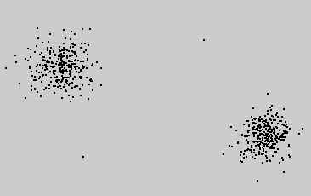
Distance-based Approaches
DB(ε,π)-Outliers
Basic model [Knorr and Ng 1997]
Given a radius ε and a percentage π
A point p is considered an outlier if at most π percent of all other points have a distance to p less than ε
ε
range-query with radius ε
p₁
p₂

Slide 5
Distance-based Approaches
Algorithms
Index-based [Knorr and Ng 1998]
Compute distance range join using spatial index structure
Exclude point from further consideration if its ε-neighborhood contains more than Card(DB) . π points
Nested-loop based [Knorr and Ng 1998]
Divide buffer in two parts
Use second part to scan/compare all points with the points from the first part
Grid-based [Knorr and Ng 1998]
Build grid such that any two points from the same grid cell have a distance of at most ε to each other
Points need only compared with points from neighboring cells

Slide 6
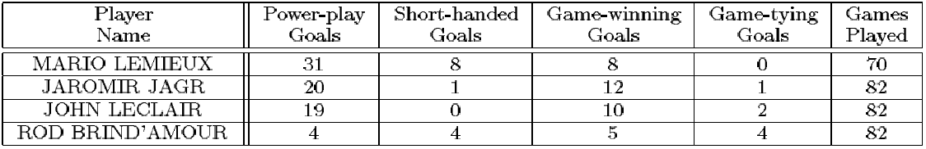
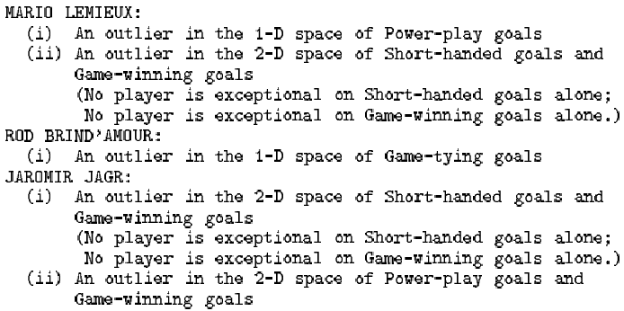
Distance-based Approaches
Deriving intensional knowledge [Knorr and Ng 1999]
Relies on the DB(ε,π)-outlier model
Find the minimal subset(s) of attributes that explains the “outlierness” of a point, i.e., in which the point is still an outlier
Example
Identified outliers
Derived intensional knowledge (sketch)

Slide 7
Distance-based Approaches
Outlier scoring based on kNN distances
General models
Take the kNN distance of a point as its outlier score [Ramaswamy et al 2000]
Aggregate the distances of a point to all its 1NN, 2NN, …, kNN as an outlier score [Angiulli and Pizzuti 2002]
Algorithms
General approaches
Nested-Loop
Naïve approach:
For each object: compute kNNs with a sequential scan
Enhancement: use index structures for kNN queries
Partition-based
Partition data into micro clusters
Aggregate information for each partition (e.g. minimum bounding rectangles)
Allows to prune micro clusters that cannot qualify when searching for the kNNs of a particular point

Slide 8
Distance-based Approaches
Sample Algorithms (computing top-n outliers)
Nested-Loop [Ramaswamy et al 2000]
Simple NL algorithm with index support for kNN queries
Partition-based algorithm (based on a clustering algorithm that has linear time complexity)
Algorithm for the simple kNN-distance model
Linearization [Angiulli and Pizzuti 2002]
Linearization of a multi-dimensional data set using space-fill curves
1D representation is partitioned into micro clusters
Algorithm for the average kNN-distance model
ORCA [Bay and Schwabacher 2003]
NL algorithm with randomization and simple pruning
Pruning: if a point has a score greater than the top-n outlier so far (cut-off), remove this point from further consideration
=> non-outliers are pruned
=> works good on randomized data (can be done in linear time)
=> worst-case: naïve NL algorithm
Algorithm for both kNN-distance models and the DB(ε,π)-outlier model

Slide 9
Distance-based Approaches
Sample Algorithms (cont.)
RBRP [Ghoting et al. 2006],
Idea: try to increase the cut-off as quick as possible => increase the pruning power
Compute approximate kNNs for each point to get a better cut-off
For approximate kNN search, the data points are partitioned into micro clusters and kNNs are only searched within each micro cluster
Algorithm for both kNN-distance models
Further approaches
Also apply partitioning-based algorithms using micro clusters [McCallum et al 2000], [Tao et al. 2006]
Approximate solution based on reference points [Pei et al. 2006]
Discussion
Output can be a scoring (kNN-distance models) or a labeling (kNN-distance models and the DB(ε,π)-outlier model)
Approaches are local (resolution can be adjusted by the user via ε or k)

Slide 10
Distance-based Approaches
Variant
Outlier Detection using In-degree Number [Hautamaki et al. 2004]
Idea
Construct the kNN graph for a data set
Vertices: data points
Edge: if q∈kNN(p) then there is a directed edge from p to q
A vertex that has an indegree less than equal to T (user defined threshold) is an outlier
Discussion
The indegree of a vertex in the kNN graph equals to the number of reverse kNNs (RkNN) of the corresponding point
The RkNNs of a point p are those data objects having p among their kNNs
Intuition of the model: outliers are
points that are among the kNNs of less than T other points have less than T RkNNs
Outputs an outlier label
Is a local approach (depending on user defined parameter k)

Slide 11
Distance-based Approaches
Resolution-based outlier factor (ROF) [Fan et al. 2006]
Model
Depending on the resolution of applied distance thresholds, points are outliers or within a cluster
With the maximal resolution Rmax (minimal distance threshold) all points are outliers
With the minimal resolution Rmin (maximal distance threshold) all points are within a cluster
Change resolution from Rmax to Rmin so that at each step at least one point changes from being outlier to being a member of a cluster
Cluster is defined similar as in DBSCAN [Ester et al 1996] as a transitive closure of r-neighborhoods (where r is the current resolution)
ROF value
Discussion
Outputs a score (the ROF value)
Resolution is varied automatically from local to global

Slide 12
Density-based Approaches
General idea
Compare the density around a point with the density around its local neighbors
The relative density of a point compared to its neighbors is computed as an outlier score
Approaches essentially differ in how to estimate density
Basic assumption
The density around a normal data object is similar to the density around its neighbors
The density around an outlier is considerably different to the density around its neighbors

Slide 13
Density-based Approaches
Local Outlier Factor (LOF) [Breunig et al. 1999], [Breunig et al. 2000]
Motivation:
Distance-based outlier detection models have problems with different densities
How to compare the neighborhood of points from areas of different densities?
Example
DB(ε,π)-outlier model
Parameters ε and π cannot be chosen
so that o₂ is an outlier but none of the
points in cluster C₁ (e.g. q) is an outlier
Outliers based on kNN-distance
kNN-distances of objects in C₁ (e.g. q)
are larger than the kNN-distance of o₂
Solution: consider relative density
q

Slide 14
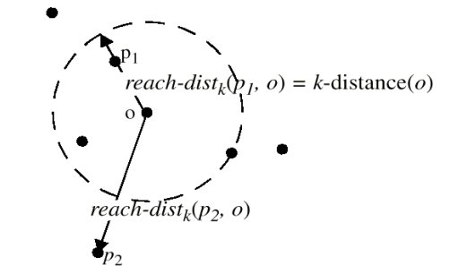
Density-based Approaches
Model
Reachability distance
Introduces a smoothing factor
Local reachability distance (lrd) of point p
Inverse of the average reach-dists of the kNNs of p
Local outlier factor (LOF) of point p
Average ratio of lrds of neighbors of p and lrd of p

Slide 15
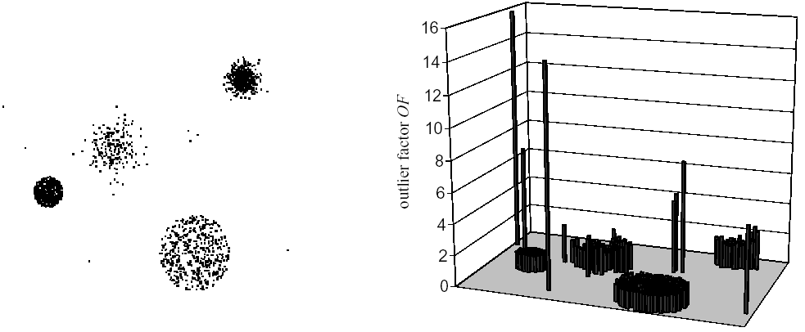
Density-based Approaches
Properties
LOF ≈ 1: point is in a cluster
(region with homogeneous
density around the point and
its neighbors)
LOF >> 1: point is an outlier
Discussion
Choice of k (MinPts in the original paper) specifies the reference set
Originally implements a local approach (resolution depends on the user’s choice for k)
Outputs a scoring (assigns an LOF value to each point)
Data set
LOFs (MinPts = 40)

Slide 16
Density-based Approaches
Variants of LOF
Mining top-n local outliers [Jin et al. 2001]
Idea:
Usually, a user is only interested in the top-n outliers
Do not compute the LOF for all data objects => save runtime
Method
Compress data points into micro clusters using the CFs of BIRCH [Zhang et al. 1996]
Derive upper and lower bounds of the reachability distances, lrd-values, and LOF-values for points within a micro clusters
Compute upper and lower bounds of LOF values for micro clusters and sort results w.r.t. ascending lower bound
Prune micro clusters that cannot accommodate points among the top-n outliers (n highest LOF values)
Iteratively refine remaining micro clusters and prune points accordingly

Slide 17
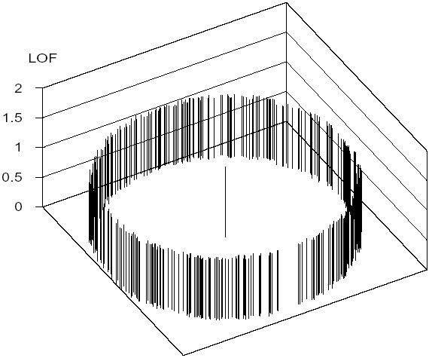
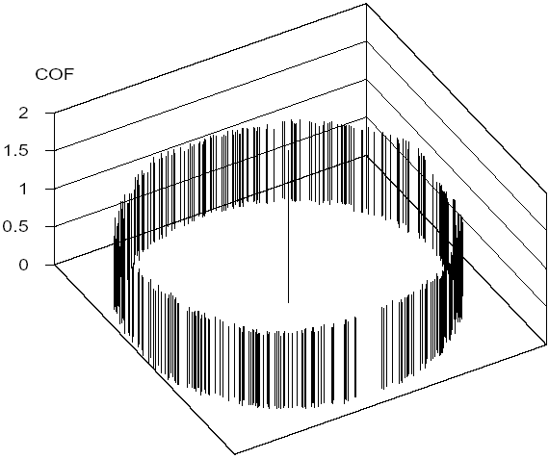
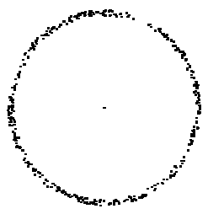
Density-based Approaches
Variants of LOF (cont.)
Connectivity-based outlier factor (COF) [Tang et al. 2002]
Motivation
In regions of low density, it may be hard to detect outliers
Choose a low value for k is often not appropriate
Solution
Treat “low density” and “isolation” differently
Example
Data set
LOF
COF

Slide 18
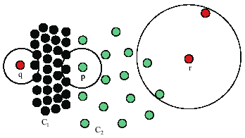
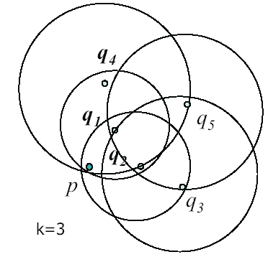
Density-based Approaches
Influenced Outlierness (INFLO) [Jin et al. 2006]
Motivation
If clusters of different densities are not clearly separated, LOF will have problems
Idea
Take symmetric neighborhood relationship into account
Influence space (kIS(p)) of a point p includes its kNNs (kNN(p)) and its reverse kNNs (RkNN(p))
Point p will have a higher LOF than points q or r which is counter intuitive
kIS(p) = kNN(p) ∪ RkNN(p))
= {q₁, q₂, q₄}

Slide 19
Density-based Approaches
Model
Density is simply measured by the inverse of the kNN distance, i.e.,
den(p) = 1/k-distance(p)
Influenced outlierness of a point p
INFLO takes the ratio of the average density of objects in the neighborhood of a point p (i.e., in kNN(p) ∪ RkNN(p)) to p’s density
Proposed algorithms for mining top-n outliers
Index-based
Two-way approach
Micro cluster based approach

Slide 20
Density-based Approaches
Properties
Similar to LOF
INFLO ≈ 1: point is in a cluster
INFLO >> 1: point is an outlier
Discussion
Outputs an outlier score
Originally proposed as a local approach (resolution of the reference set kIS can be adjusted by the user setting parameter k)

Slide 21
Density-based Approaches
Local outlier correlation integral (LOCI) [Papadimitriou et al. 2003]
Idea is similar to LOF and variants
Differences to LOF
Take the ε-neighborhood instead of kNNs as reference set
Test multiple resolutions (here called “granularities”) of the reference set to get rid of any input parameter
Model
ε-neighborhood of a point p: N(p,ε) = {q | dist(p,q) ≤ ε}
Local density of an object p: number of objects in N(p,ε)
Average density of the neighborhood
Multi-granularity Deviation Factor (MDEF)

Slide 22
Density-based Approaches
N(p₁, α . ε)
N(p,ε)
N(p,α . ε)
Intuition
σMDEF(p,ε,α) is the normalized standard deviation of the densities of all points from N(p,ε)
Properties
MDEF = 0 for points within a cluster
MDEF > 0 for outliers or MDEF > 3.σMDEF => outlier
N(p₂, α . ε)
N(p₃, α . ε)

Slide 23
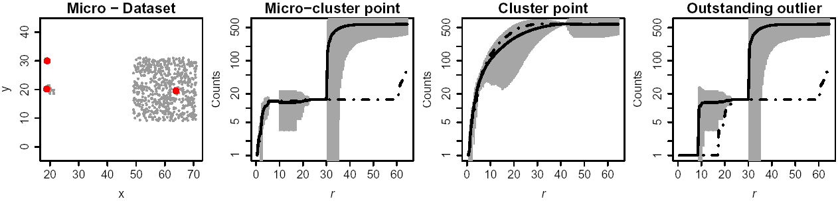
Density-based Approaches
Features
Parameters ε and α are automatically determined
In fact, all possible values for ε are tested
LOCI plot displays for a given point p the following values w.r.t. ε
Card(N(p, α.ε))
den(p, ε, α) with a border of ± 3.σden(p, ε, α)
ε
ε
ε

Slide 24
Density-based Approaches
Algorithms
Exact solution is rather expensive (compute MDEF values for all possible ε values)
aLOCI: fast, approximate solution
Discretize data space using a grid with side
length 2αε
Approximate range queries trough grid cells
ε - neighborhood of point p: ζ(p,ε)
all cells that are completely covered by
ε-sphere around p
Then,
where c_{j} is the object count the corresponding cell
Since different ε values are needed, different grids are constructed with varying resolution
These different grids can be managed efficiently using a Quad-tree
pi
ε
2αε
p
2αε

Slide 25
Density-based Approaches
Discussion
Exponential runtime w.r.t. data dimensionality
Output:
Score (MDEF) or
Label: if MDEF of a point > 3.σMDEF then this point is marked as outlier
LOCI plot
At which resolution is a point an outlier (if any)
Additional information such as diameter of clusters, distances to clusters, etc.
All interesting resolutions, i.e., possible values for ε, (from local to global) are tested

Slide 26
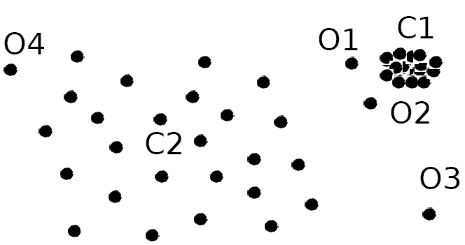
Density-Based Outlier Detection
Local outliers: Outliers comparing to their local neighborhoods, instead of the global data distribution
In Fig., o₁ and o2 are local outliers to C₁, o₃ is a global outlier, but o₄ is not an outlier. However, proximity-based clustering cannot find o₁ and o₂ are outlier (e.g., comparing with O₄).
Intuition (density-based outlier detection): The density around an outlier object is significantly different from the density around its neighbors
Method: Use the relative density of an object against its neighbors as the indicator of the degree of the object being outliers
k-distance of an object o, dist_{k}(o): distance between o and its k-th NN
k-distance neighborhood of o, N_{k}(o) = {o’| o’ in D, dist(o, o’) ≤ dist_{k}(o)}
N_{k}(o) could be bigger than k since multiple objects may have identical distance to o
26

Slide 27
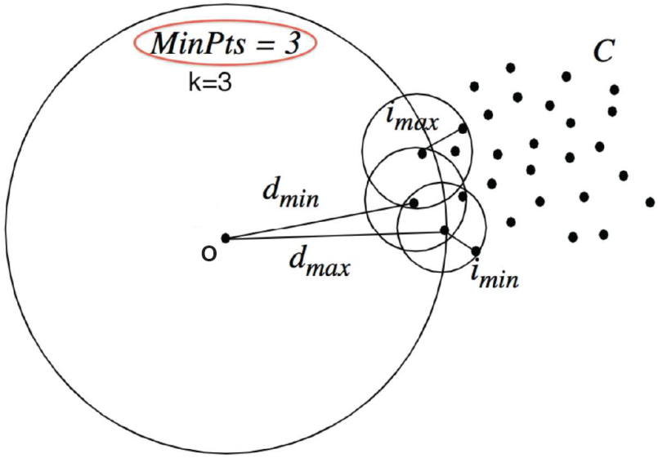
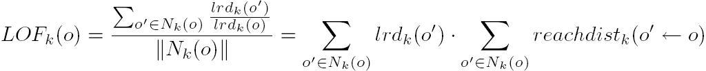
Local Outlier Factor: LOF
Reachability distance from o’ to o:
where k is a user-specified parameter
Local reachability density of o:
LOF (Local outlier factor) of an object o is the average of the ratio of local reachability of o and those of o’s k-nearest neighbors
The lower the local reachability density of o, and the higher the local reachability density of the kNN of o, the higher LOF
This captures a local outlier whose local density is relatively low comparing to the local densities of its kNN
27

Slide 28
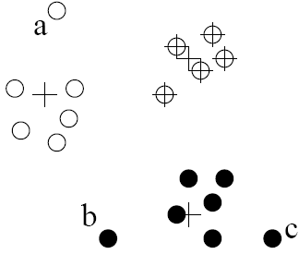
Clustering-Based Outlier Detection (1 & 2): Not belong to any cluster, or far from the closest one
An object is an outlier if (1) it does not belong to any cluster, (2) there is a large distance between the object and its closest cluster , or (3) it belongs to a small or sparse cluster
Case I: Not belong to any cluster
Identify animals not part of a flock: Using a density-based clustering method such as DBSCAN
Case 2: Far from its closest cluster
Using k-means, partition data points of into clusters
For each object o, assign an outlier score based on its distance from its closest center
If dist(o, c_{o})/avg_dist(c_{o}) is large, likely an outlier
Ex. Intrusion detection: Consider the similarity between data points and the clusters in a training data set
Use a training set to find patterns of “normal” data, e.g., frequent itemsets in each segment, and cluster similar connections into groups
Compare new data points with the clusters mined—Outliers are possible attacks
28

Slide 29
Clustering-Based Outlier Detection (3): Detecting Outliers in Small Clusters
FindCBLOF: Detect outliers in small clusters
Find clusters, and sort them in decreasing size
To each data point, assign a cluster-based local outlier factor (CBLOF):
If obj p belongs to a large cluster, CBLOF = cluster_size X similarity between p and cluster
If p belongs to a small one, CBLOF = cluster size X similarity betw. p and the closest large cluster
Ex. In the figure, o is outlier since its closest large cluster is C₁, but the similarity between o and C₁ is small. For any point in C₃, its closest large cluster is C₂ but its similarity from C₂ is low, plus |C₃| = 3 is small
29

Slide 30
Clustering-Based Method: Strength and Weakness
Strength
Detect outliers without requiring any labeled data
Work for many types of data
Clusters can be regarded as summaries of the data
Once the cluster are obtained, need only compare any object against the clusters to determine whether it is an outlier (fast)
Weakness
Effectiveness depends highly on the clustering method used—they may not be optimized for outlier detection
High computational cost: Need to first find clusters
A method to reduce the cost: Fixed-width clustering
A point is assigned to a cluster if the center of the cluster is within a pre-defined distance threshold from the point
If a point cannot be assigned to any existing cluster, a new cluster is created and the distance threshold may be learned from the training data under certain conditions

Slide 31
Reference
https://www.siam.org/meetings/sdm10/tutorial3.pdf

